Slide 3
BCN Digital Finance Hub
Harness the power of data science and technology to revolutionize financial processes globally
Evolution of the hub
50
Data
Scientists
Finance
Profiles
40
28
Our
mission
The team
Software Engineers & Devops
10
Reimagine medicine to improve people’s lives
2018
2020
2022
2023
Diverse team with +11 different nationalities
Background
Mathematics & Statistics
Our position at Novartis
Finance
Computer Science
Economics
Innovative Medicine
Global Drug Development
Technical Operations
Group BPA
Physics & Others
Engineering
Digital Finance
60% Local talent
BCN
Hub

Slide 4
The Daily Sales Problem
The current Sales prediction is a monthly based forecast.
Business needs to anticipate if a given country brand will over/under perform the expected target.
Daily Sales Phasing is defined as the ratio of the monthly sales for each working date (WD) within a month.
Sales are not equally distributed within a month. The shipping patterns might differ for different countries and brands. Example:
Country A: Daily shipping pattern depends mostly on the weekdays. For instance, drug A is mostly sold on Tuesdays and Thursdays and barely sold elsewhere.
Country B: Daily shipping pattern is highly correlated on the working date number.
Sales
X
MAY
100%
Phasing
0%
1 | 2 | 3 | 4 | 5 | 6 | 7 | 8 | 9 | 10
11 | 12 | 13 | 14 | 15 | 16 | 17 | 18 | 19 | 20
Working Day

Slide 5
Challenge
Splitting monthly sales into working day phasing

Slide 6
Technical challenge
Predict the daily phasing for each brand in the test-set for each month in the year 2022.
Leverage historical information from 2013-2021.
Top 5 best metrics will proceed to the business challenge.

Slide 7
Business challenge
The challenge has a strong business component.
It is not only about how you solve the problem, but also about why you solved it this way.
The end user of the forecast is a business team. So, your solution needs to be clear and preferably explainable.
The top 3 teams will be selected based on their presentation to a jury.
The jury members’ background is mixed between technical and business.

Slide 8
Data
All the data is provided in a single dataframe, with features divided into:
Identifiers
Calendar related
Business related
Target & auxiliar

Slide 9
Data identifiers
Brand: Brand of the drug being sold.
Country: Country in which the drug is being sold.
Date: Date in format DD/MM/YYYY.
brand | country | Date
brand_1 | country_3 | 01/01/2018
brand_1 | country_3 | 02/01/2018
brand_1 | country_3 | 03/01/2018
brand_1 | country_3 | 04/01/2018

Slide 10
Calendar features
Dayweek: Monday=0, Tuesday=1,...
Month: January=0, February=1,...
N_weekday_X: Number of working dates in Mondays (0), Tuesdays(1),... in the current month.
Wd: # of working date in current month.
Wd_left: # of working dates left until the end of the month
N_nwd_aft: Number of wd after a given wd which were non-working dates.
N_nwd_bef: Number of wd before a given wd which were non-working dates.
Dayweek | Month | N_weekday_0 | Wd | Wd_left | N_nwd_aft | N_nwd_bef
0 | 2 | 4 | 4 | 16 | 0 | 1
1 | 2 | 4 | 5 | 15 | 1 | 0

Slide 11
Business features
Ther_area: Encoded therapeutic area of the drug.
Hospital_rate: Percentage of the sales of that country-brand which are sold in hospitals, compared to other distribution channels.
Main_channel: Main distribution channel of sales (Hospital, Retail, Others).
Ther_area | Hospital_rate​ | Main_channel
A | 0.001 | Hospital
B | 0.0012 | Retail
A | 0.0015 | Hospital
D | 0.0011 | Others

Slide 12
Target & auxiliar features
Phase: Target, daily sales percentage. Important: Sum of phases of a same country-brand-month must be 1 (+-0.0001). Failure to meet this constraint will fail submission.
Monthly_sales: Auxiliar feature, sum of sales per month, transformed non-linearly. Important: this feature, like Phase, is not available in the test set. No need to predict or use it.
Phase | Monthly_sales
0.01 | 0.14
0.15 | 0.11
0.05 | 0.12
0.01 | 0.15

Slide 13
Hints
Do an outlier detection
Create lags variables may be useful

Slide 14
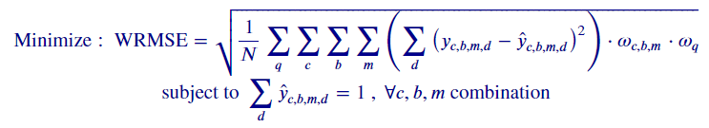
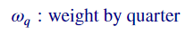
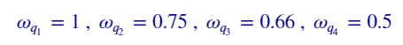
Accuracy Metric:
Understanding the metric:
Data Segmentation
Error Computation
Weight Assignment
Summation
Temporal Weighting
Constraint
Nomenclature:

Slide 16
Technical part
Communication: Microsoft Teams​
Upload the results: Datathon Platform​

Slide 17
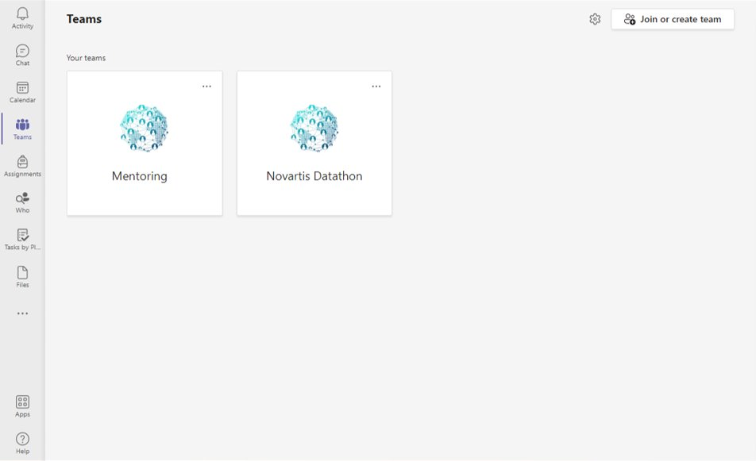
Communication Channel
Private
Communication
with Mentors and Staff
General
Communication

Slide 18
Communication Channel
Private
Communication
with Mentors and Staff

Slide 19
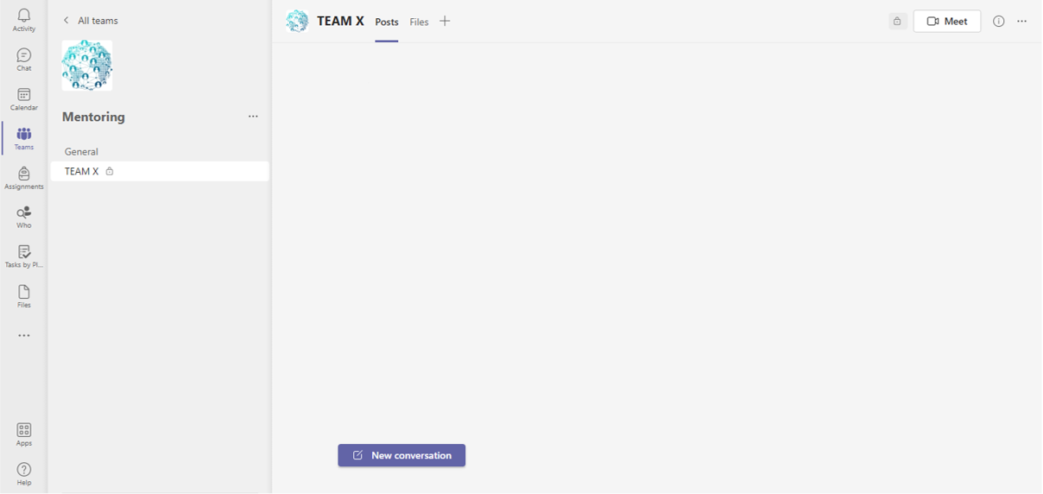
Communication Channel – Private communication
Videoconferences will be scheduled for the mentoring sessions

Slide 20
Communication Channel
General Communication

Slide 21
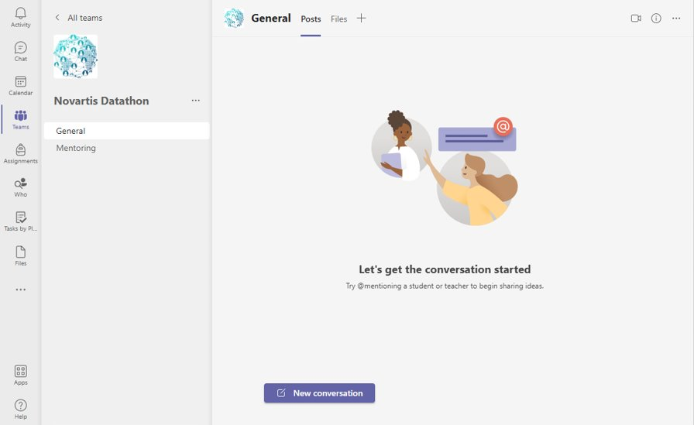
Communication Channel – General communication
Private
Communication
with Mentors and Staff
General
Communication

Slide 22
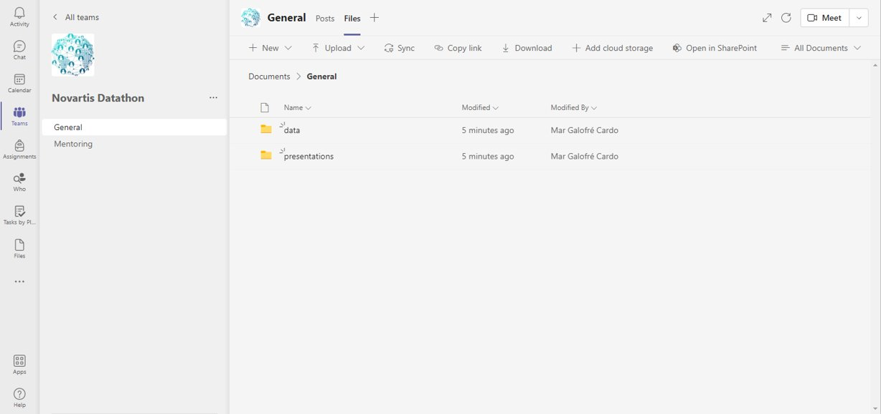
Download data

Slide 23
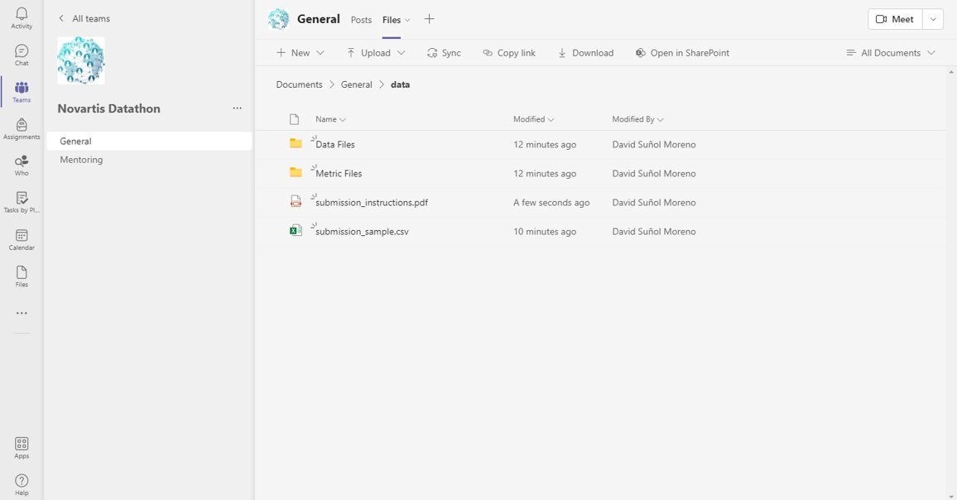
Download data

Slide 24
Download data

Slide 25
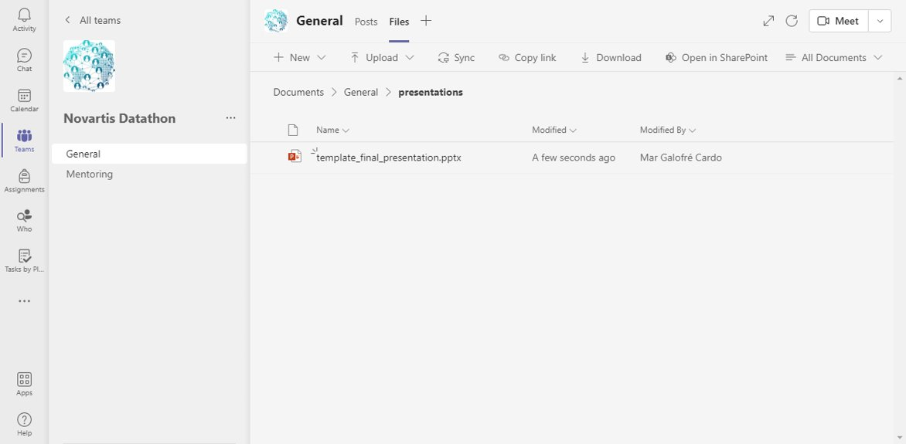
Submit presentation & code TOP 5

Slide 26
Communication Channel – General communication
Private
Communication
with Mentors and Staff
General
Communication

Slide 27
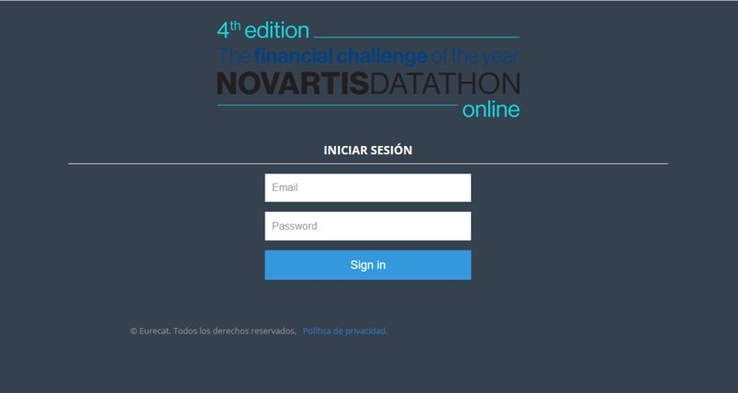

Platform login
Credentials
user: teamX@novartisdatathon
password: pwdteamX

Slide 28
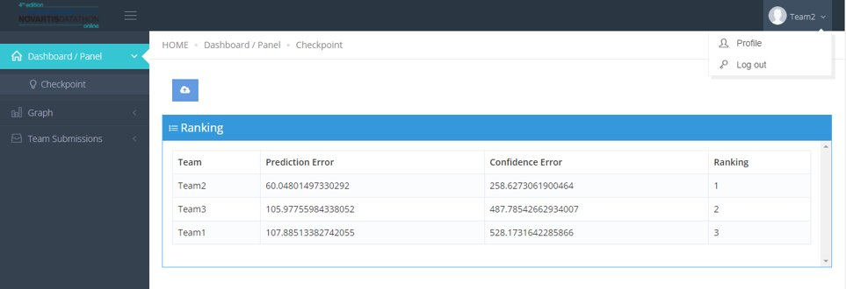
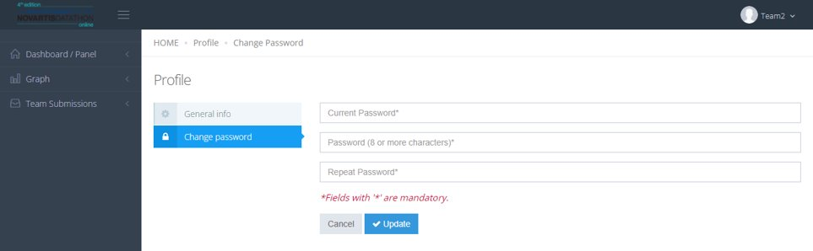
How to submit results – Change the password
1
2

Slide 29
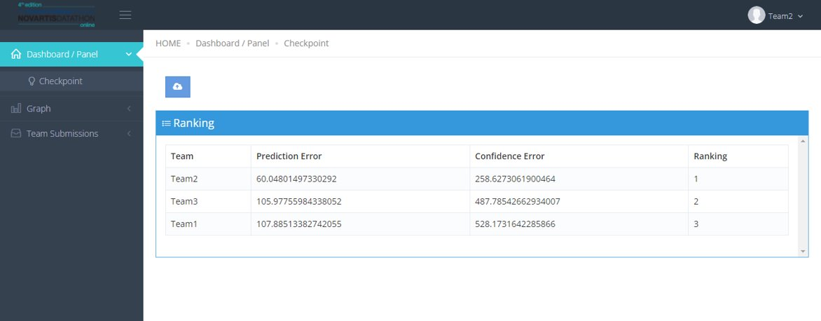
How to submit results – Submission
Team
Metric
Ranking

Slide 30
How to submit results – Ranking checkpoints
Errors calculated only over a specific % of the test set
Team
Metric
Ranking
Your best submission is shown

Slide 31
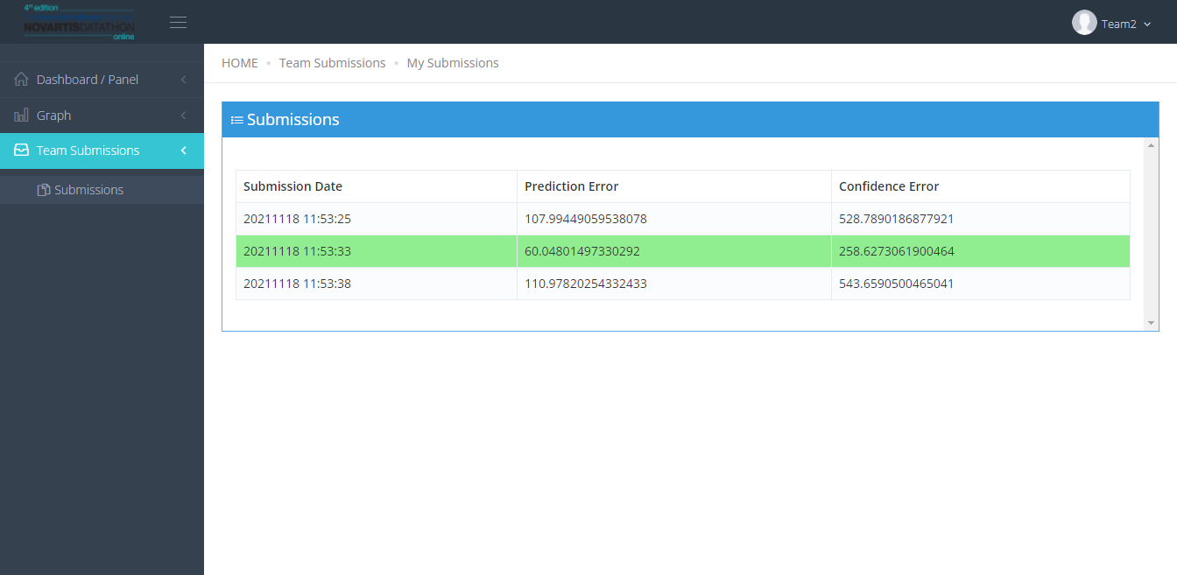
How to submit results – History of submissions
Submission Date
Metric
Limited number of submissions

Slide 32
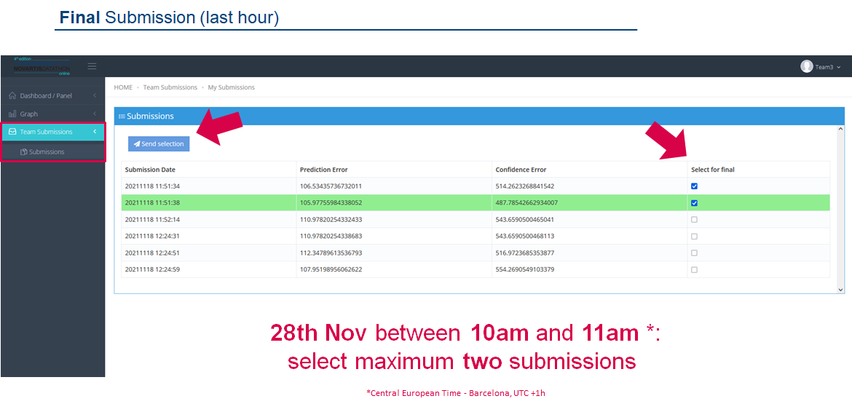
How to submit results – Final submission (last hour)
Submission Date
Metric
Select for final
27th Nov between 9:30am and 10:30am *:
Select a maximum number of submissions

Slide 33
How to submit results
FINAL results calculated over the 100% of the test set
once the submission deadline is over
(26th Nov 10:30am)

Slide 34
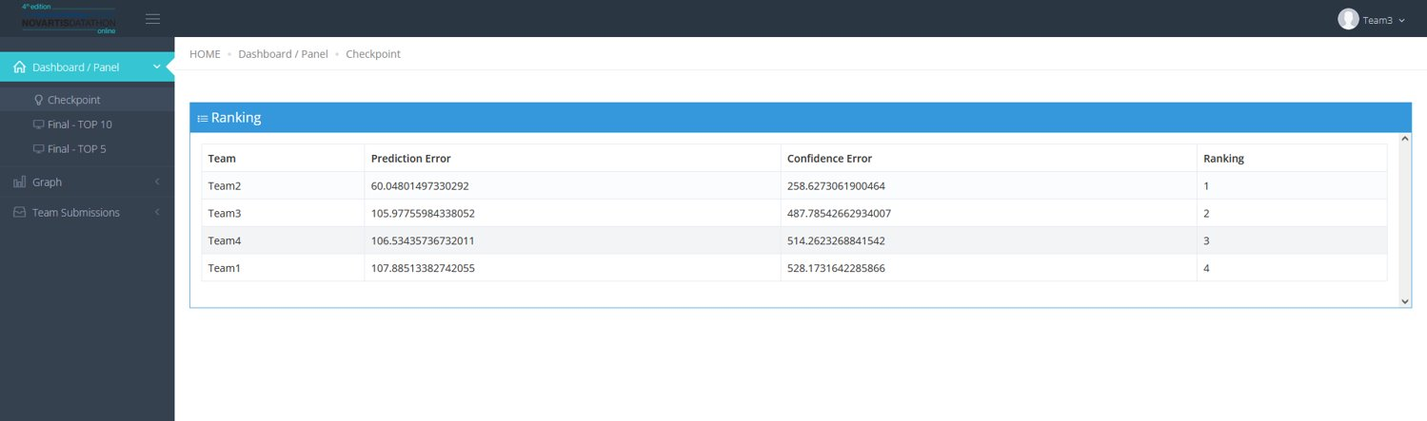
Show results
Team
Metric
Ranking
Top 5

Slide 35
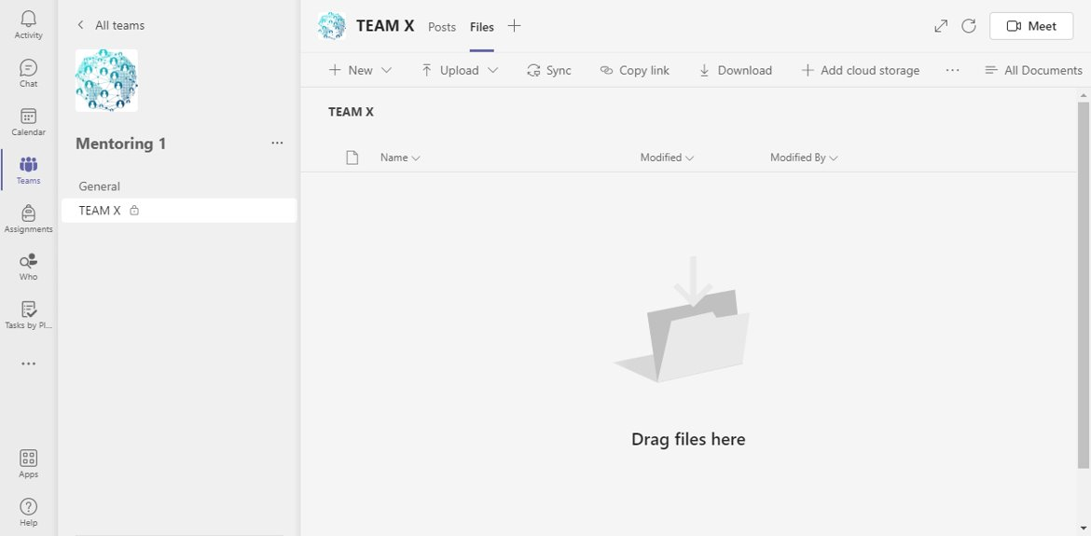
Submit presentation & code TOP 5
1
Data_Novartis_Datathon-Results_Presentation_TeamX
2
Data_Novartis_Datathon-Final_Code_TeamX

Slide 36
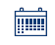
Agenda
THU 23 November
17:00h – 18:00h | Kick-off
18:00h – ... | Q&A on Teams Platform
FRI 24 November
09:00h – 18:00h | Attendance of questions
09:00h – 12:00h | Mentoring
16:00h – 18:00h | Mentoring
SAT 25 November
09:00h – 18:00h | Attendance of questions
09:00h – 12:00h | Mentoring
16:00h – 18:00h | Mentoring
SUN 26 November
09:00h | Welcome and Jury introduction
09:30h – 10:30h | Final submissions
10:30h | Deadline Submit final csv
11:30h | Show Results
12:00h | Deadline to upload TOP5 presentation
13:00h – 14:30h | Finalists' presentations TOP 5
14:30h – 15:00h | Jury deliberates
15:00h | Announcement of the Winners
*Central European Time - Barcelona, UTC +1h

